Slide 1
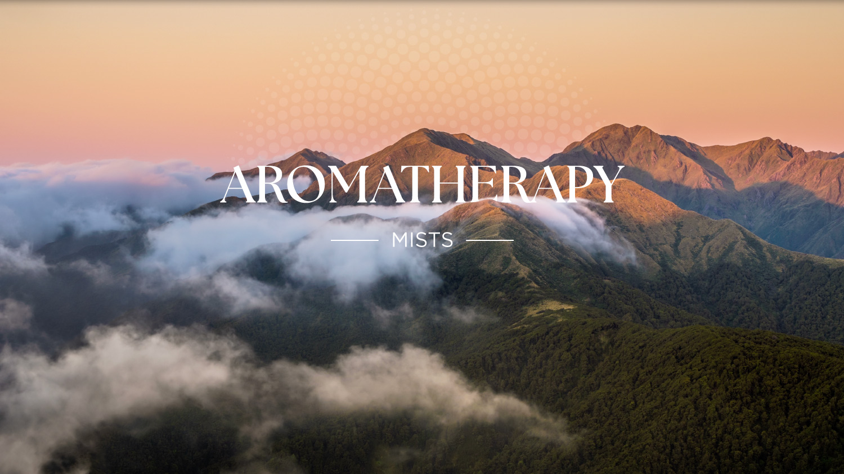

Slide 2

Overview
Product Benefits
Key Ingredients
Key Features
How to Use
Product Offering
Aromatherapy Mists
​

Slide 3
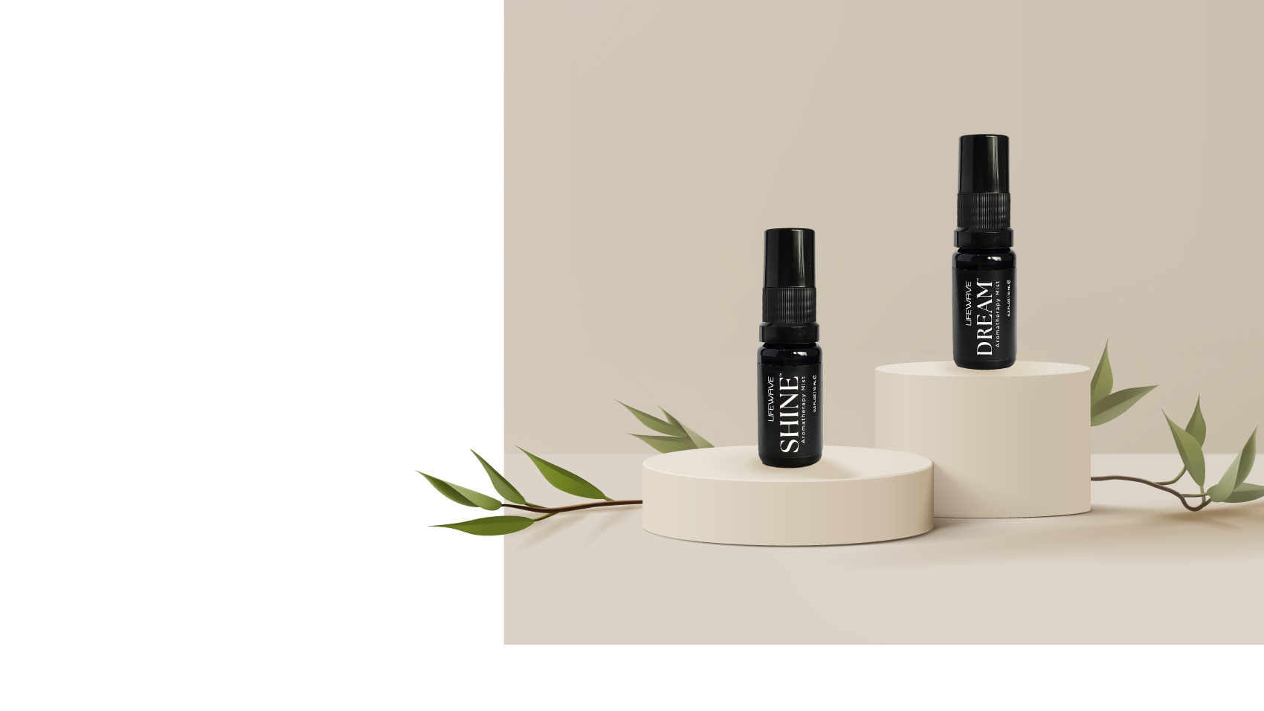

Introducing the LifeWave
Aromatherapy
Mists
LifeWave Shine & LifeWave Dream Aromatherapy Mists are your new must-have morning & evening essentials, so let’s do a quick overview of the benefits of each product.

Slide 4
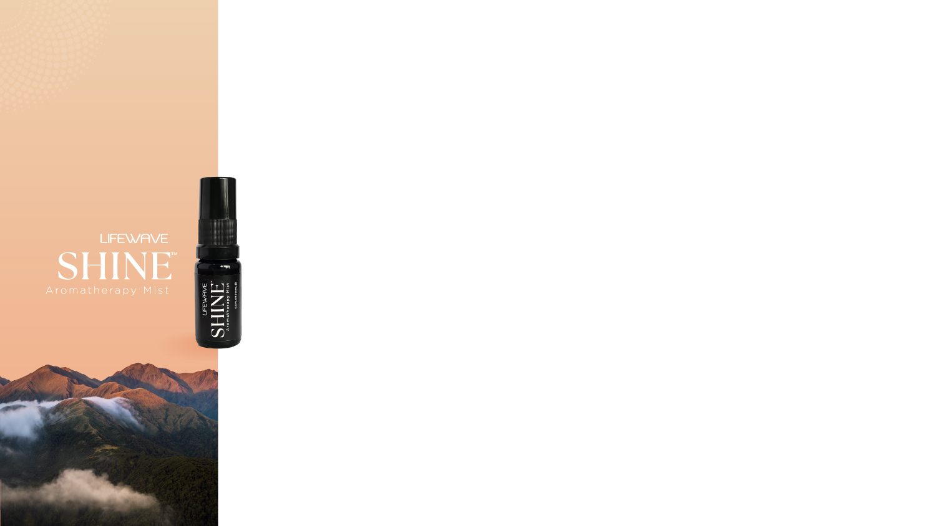
LifeWave Shine™ Benefits
Every day is your day to shine.
LifeWave Shine aromatherapy mist is a blend of natural herbs and essential oils embedded into a proprietary energized and structured water allowing for rapid results.
Encourage feeling of overall wellness and energy
Instant invigorating aroma to help awaken the senses in the morning​
Helps create a focused energizing boost for the day ahead
Let the invigorating aroma give you a pre-workout boost
Aromatherapy Mists
​

Slide 5

LifeWave Dream™ Benefits
Beyond your wildest dreams.
LifeWave Dream aromatherapy mist is a natural blend of calming ingredients that create a zen-like environment and promote feelings of peace at bedtime as you unwind and relax.
Encourage feelings of rest and relaxation​
Soothe your senses with a peaceful aroma ​
Creates a calming ambiance for your bedtime routine
Aromatherapy Mists
​

Slide 6
Key Ingredients
The LifeWave Aromatherapy mists are infused with a
science backed blend of natural ingredients.​

Slide 7
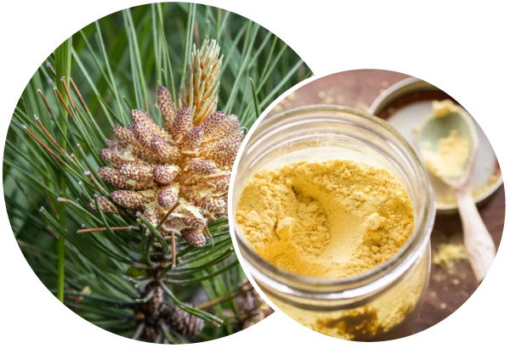
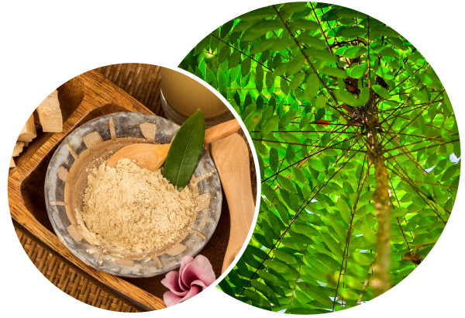
Key Ingredients
Both LifeWave Shine & LifeWave Dream contain Canadian Pine Pollen & Tongkat Ali
Canadian Pine Pollen​
Tongkat Ali​
Canadian Pine Pollen contains over 200 nutrients, including plant hormones that are known to impact upon immune system activity, and stem cell growth. It also contains Glutathione, known as the bodies ‘master antioxidant’ and Superoxide Dismutase (SOD), an antioxidant made in the mitochondria that is a powerful anti-inflammatory involved in tissue repair.
For centuries, people have used Tongkat Ali for its purported testosterone, strength, and energy benefits. A study evaluating the testosterone promoting benefits of Tongkat Ali also discovered higher levels of energy and physical strength among athletes taking a Tongkat Ali supplement compared to those not taking the supplement. ​
Aromatherapy Mists
​

Slide 8

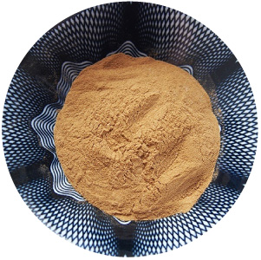
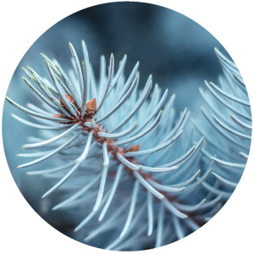
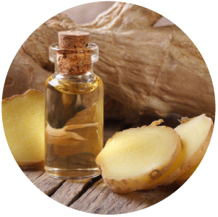
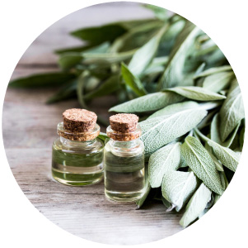
Key Ingredients
Polyrhachis Extract
Polyrhachis Ant (Black Mountain Ant) Extract is one of the premier ancient Chinese tonics, with a history of use spanning 3000 years. It has been named the "Herb of Kings" and for good reason, it is a nutrient dense superfood, containing a large amount of protein, vitamins, minerals and potent antioxidants.​
Blue Spruce Oil
Blue Spruce essential oil soothes tired muscles when applied topically with massage, enhances masculinity, and has a grounding aroma that is perfect for use in your spiritual practice.*​
Ginger Oil
Ginger Oil is known to reduce feelings of lethargy, agitation and fatigue.
Sage Oil
Sage Oil is known to stimulate and clarify the mind while exhibiting an uplifting, soothing, and strengthening effect on the senses to ease negative moods such as fatigue.

Slide 9

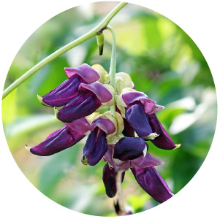
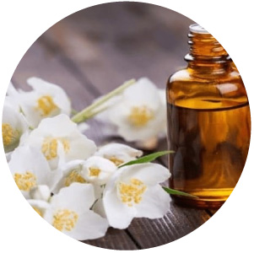
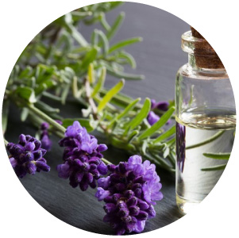
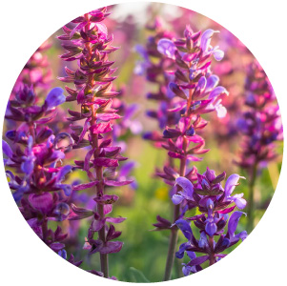
Key Ingredients
Mucuna Purines
Mucuna pruriens is a tropical legume native to Africa and tropical Asia and research has shown that this ingredient has been known to help boost dopamine levels in humans and improve sleep quality.
Jasmin Oil
Jasmine is a strong relaxant and very calming to the brain. Studies have shown that jasmine oil is a natural sleep aid that helps the brain release more Gaba, a chemical that promotes rest and relieves anxiety.
Lavender
Lavender is known to have a calming affect on the central nervous system and can promote a slow-wave sleep, helping you sleep longer and better.
Clary Sage
Clary Sage can help to alleviate stress by inducing a sense of well-being. Studies have shown that clary sage may reduce cortisol levels and since cortisol impacts circadian rhythms and appears to be tied to alertness, reducing cortisol may promote sleep.

Slide 10
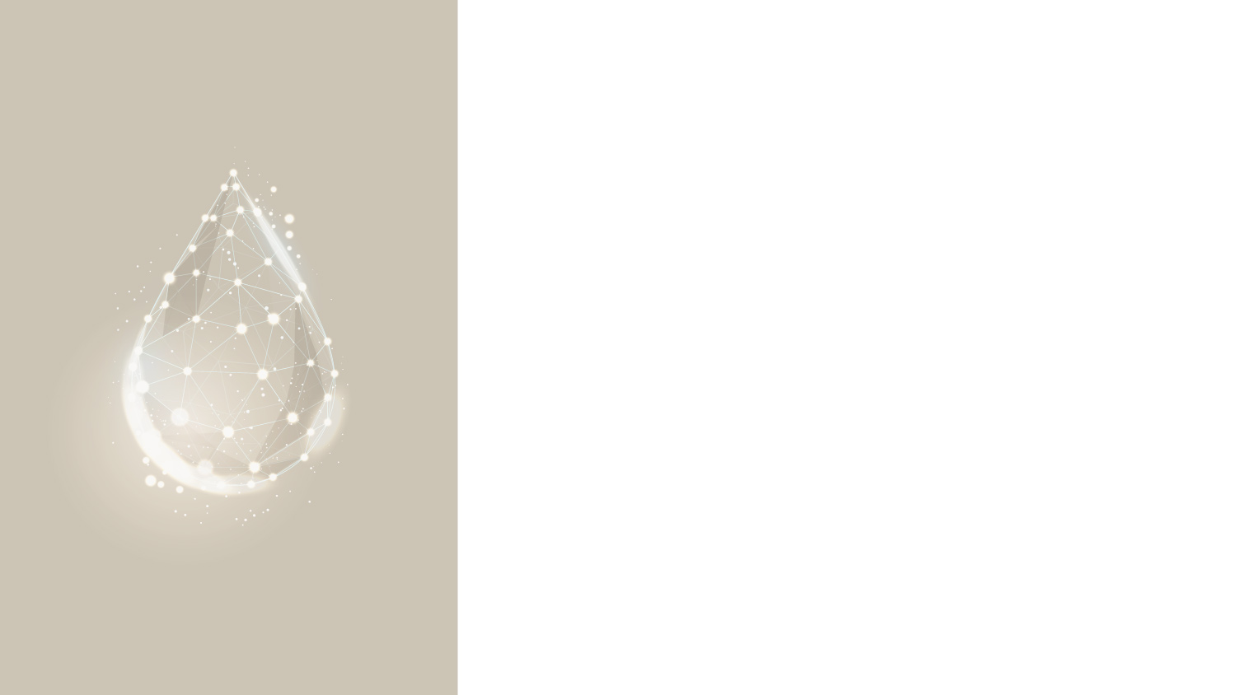
Key Feature
LifeWave Aromatherapy Mist products are made with a proprietary energized and structured water.
Specially selected natural ingredients are placed into a base of distilled water and ethanol.
These are processed with a proprietary process, developed by LifeWave CEO & Founder, David Schmidt, that alters the structure of the water, creating micro-clustered water structures, thus improving the delivery of the ingredients.
Aromatherapy Mists
​

Slide 11
How to Use
Spray on wrist and inhale to enjoy the scent.
Use Shine in the Morning and Dream in the Evening before bed.
Aromatherapy Mists
​

Slide 12
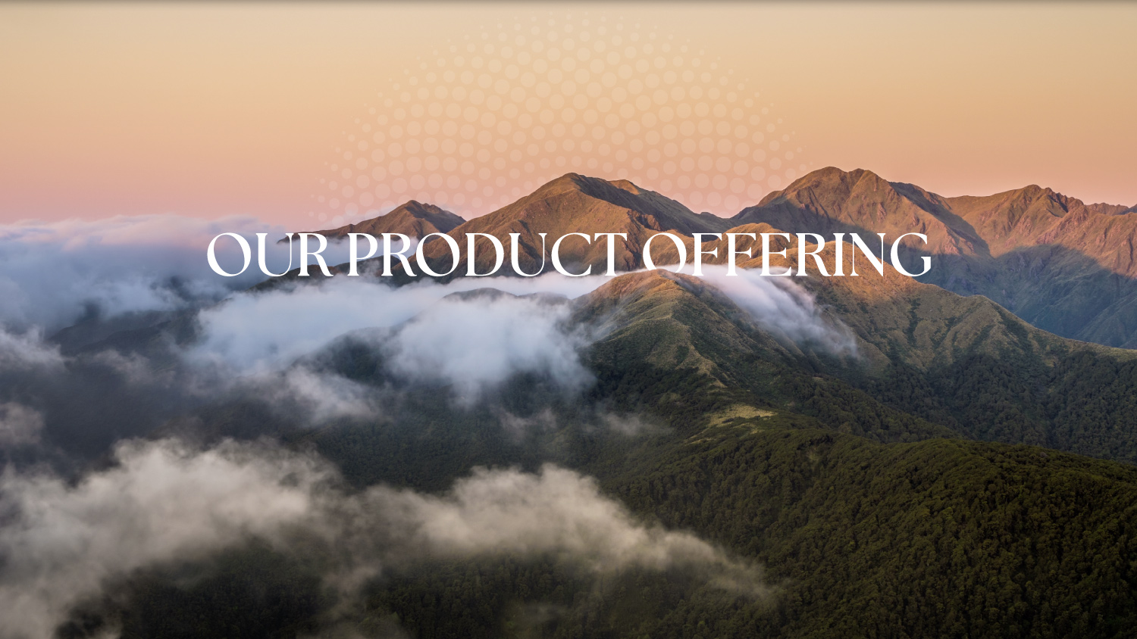

Slide 13
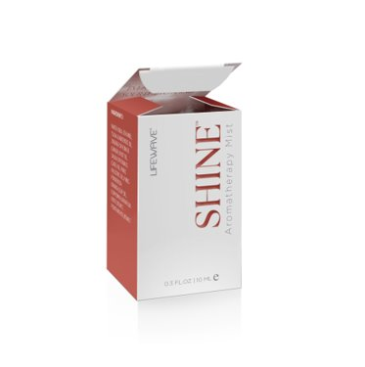
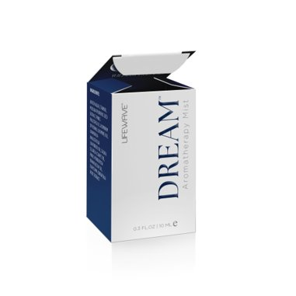


LifeWave Shine
(One Bottle)
$39.95 | 30 BV
LifeWave Dream
(One Bottle)
$39.95 | 30 BV

Slide 14
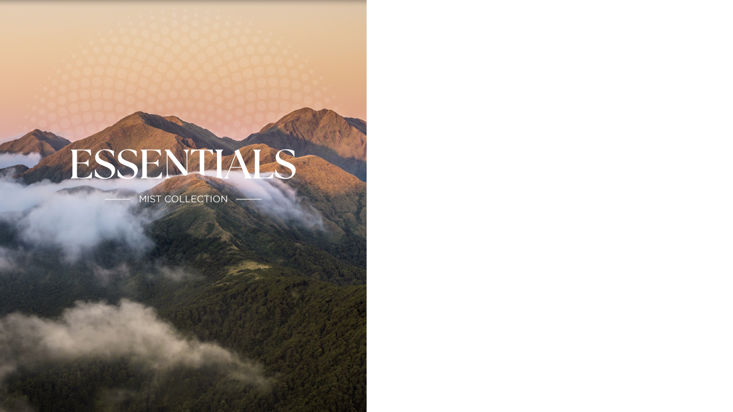
Essentials Mist Collection
Shine (one bottle) & Dream (one bottle)
$73.95 | 55 BV
Save $5.95 with this discounted bundle

Slide 15
Aromatherapy Mists
​

